Slide 1

A List Implementation That Links Data
Chapter 6
Slides by Steve Armstrong LeTourneau University Longview, TX
© 2007, Prentice Hall

Slide 2
Linked Data
Consider the analogy of desks in a classroom
Placed in classroom as needed
Each desk has a unique id, the “address”
The desks are linked by keeping the address of another chair
We have a chain of chairs

Slide 3
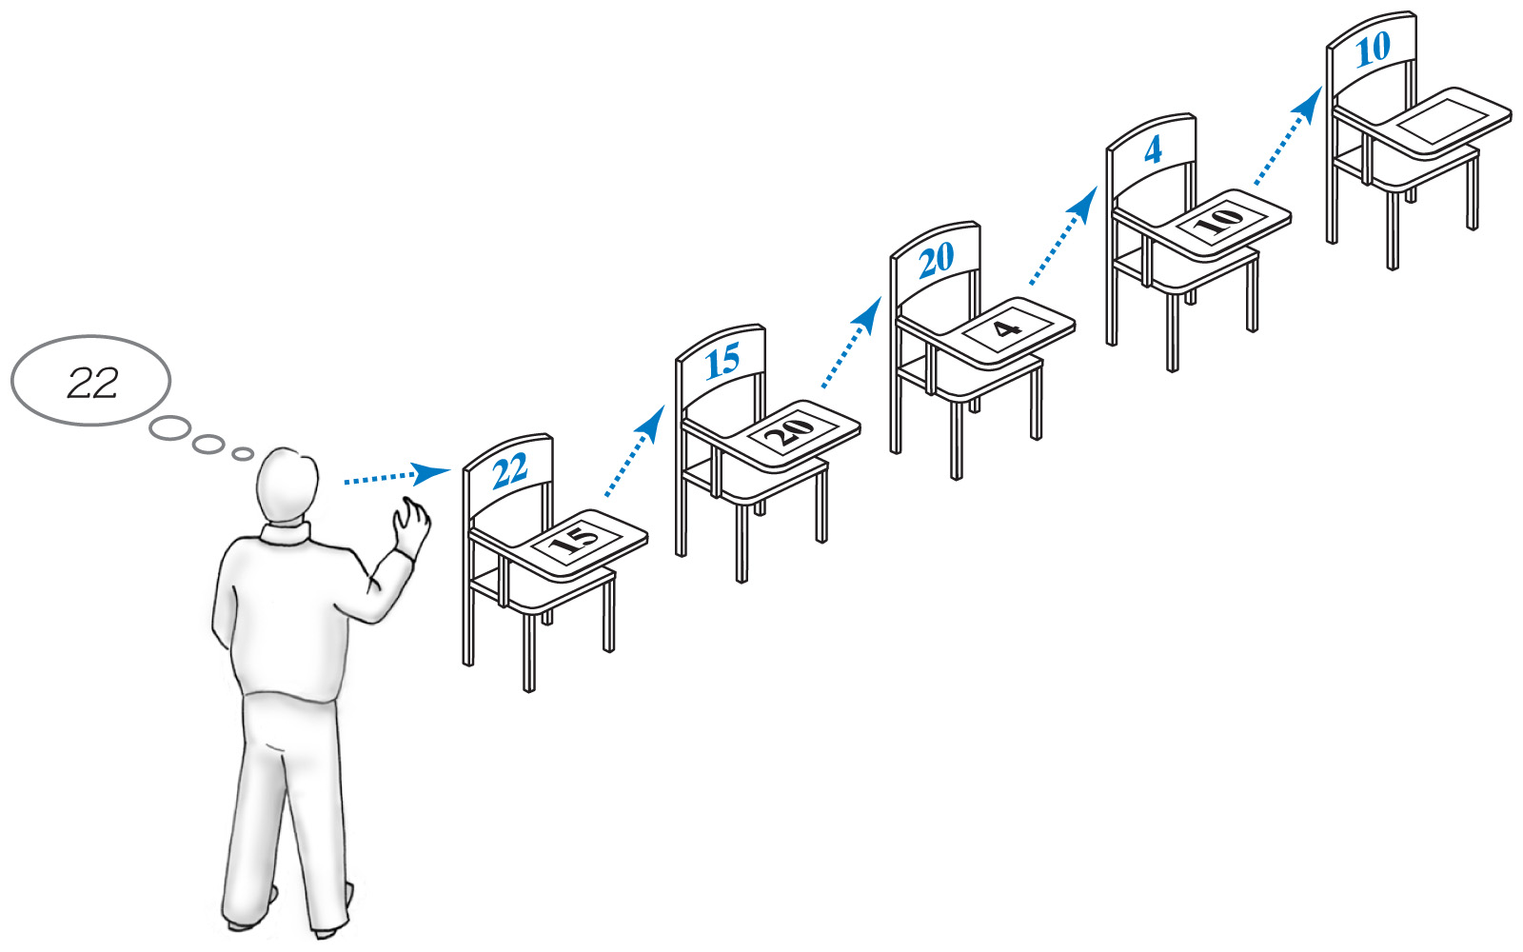
Linked Data
Fig. 6-1 A chain of 5 desks.

Slide 4
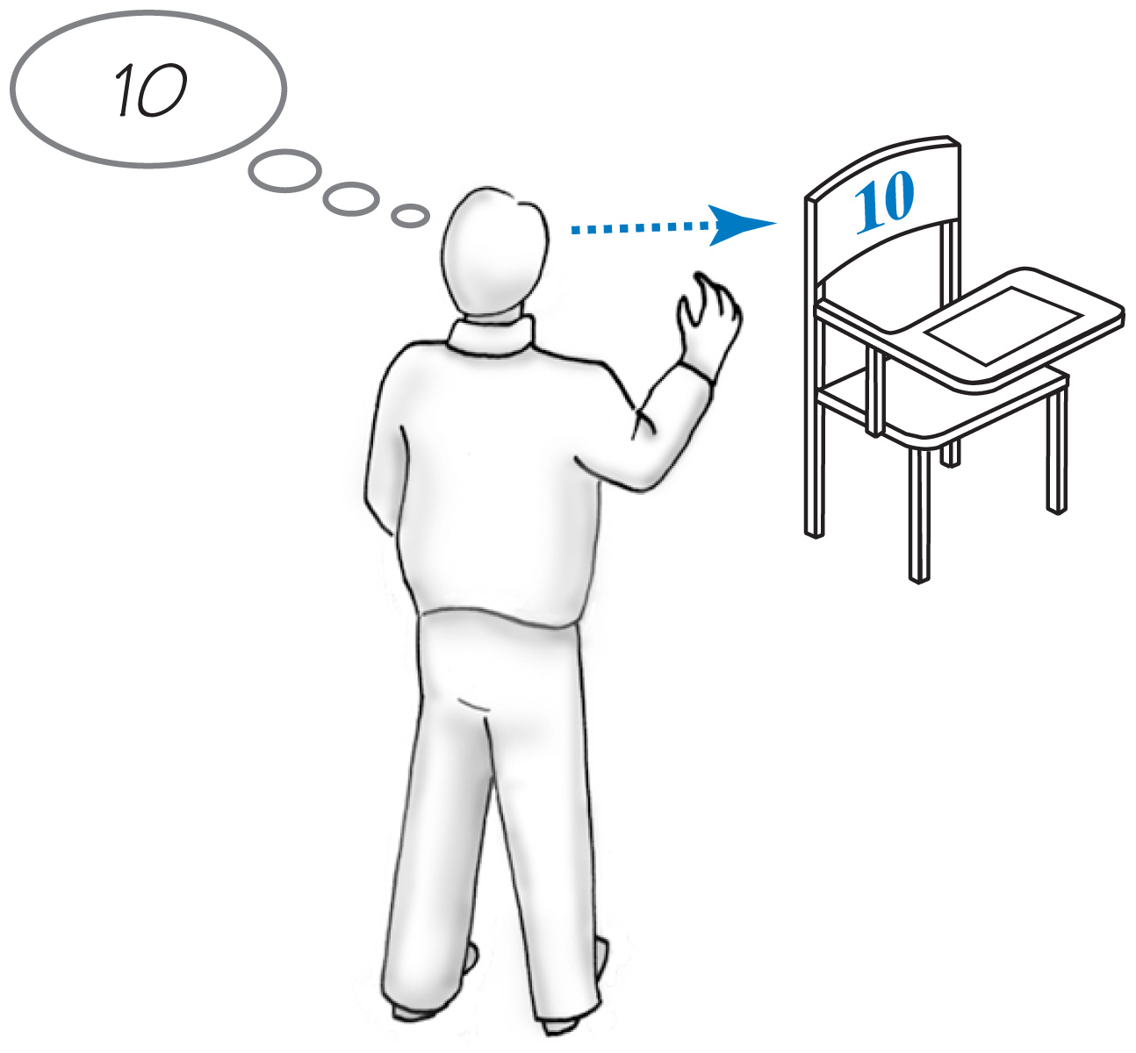
Forming a Chain by Adding to Beginning
First desk placed in room
Blank desk top, no links
Address of the first chair given to teacher
Fig. 6-2 One desk in the room.

Slide 5
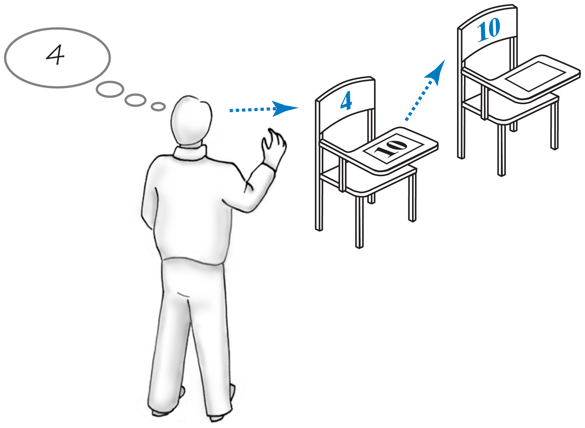
Forming a Chain by Adding to Beginning
Second student arrives, takes a desk
Address of first desk placed on new desk
Instructor “remembers” address of new desk
Fig. 6-3 Two linked desks

Slide 6
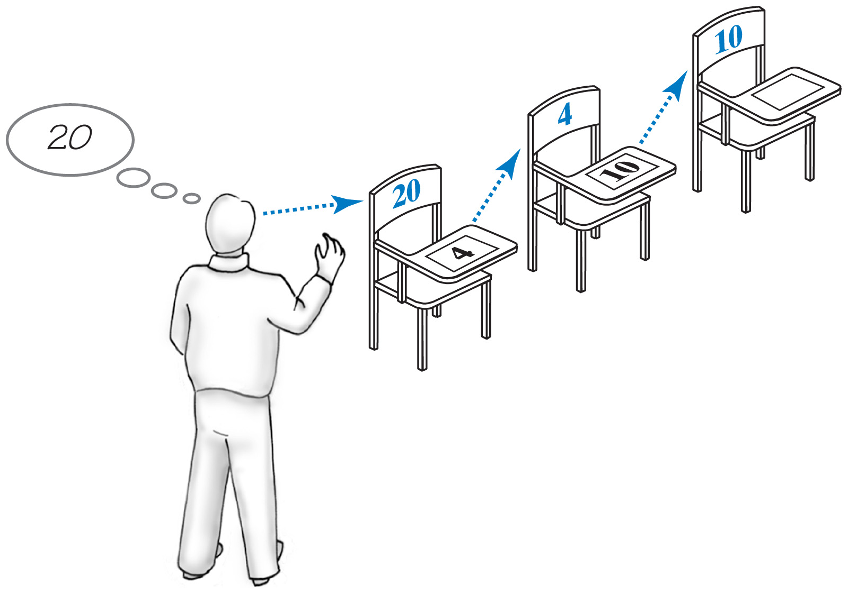
Forming a Chain by Adding to Beginning
Third desk arrives
New desk gets address of second desk
Instructor remembers address of new desk
Fig. 6-4 Three linked desks, newest desk first.

Slide 7
Forming a Chain by Adding to End
This time the first student is always at the beginning of the chain
Instructor only remembers first address
The address of a new desk is placed on the previous desk (at end of chain)
End of chain found by following links
Newest desk does not have a pointer address to any other desk

Slide 8
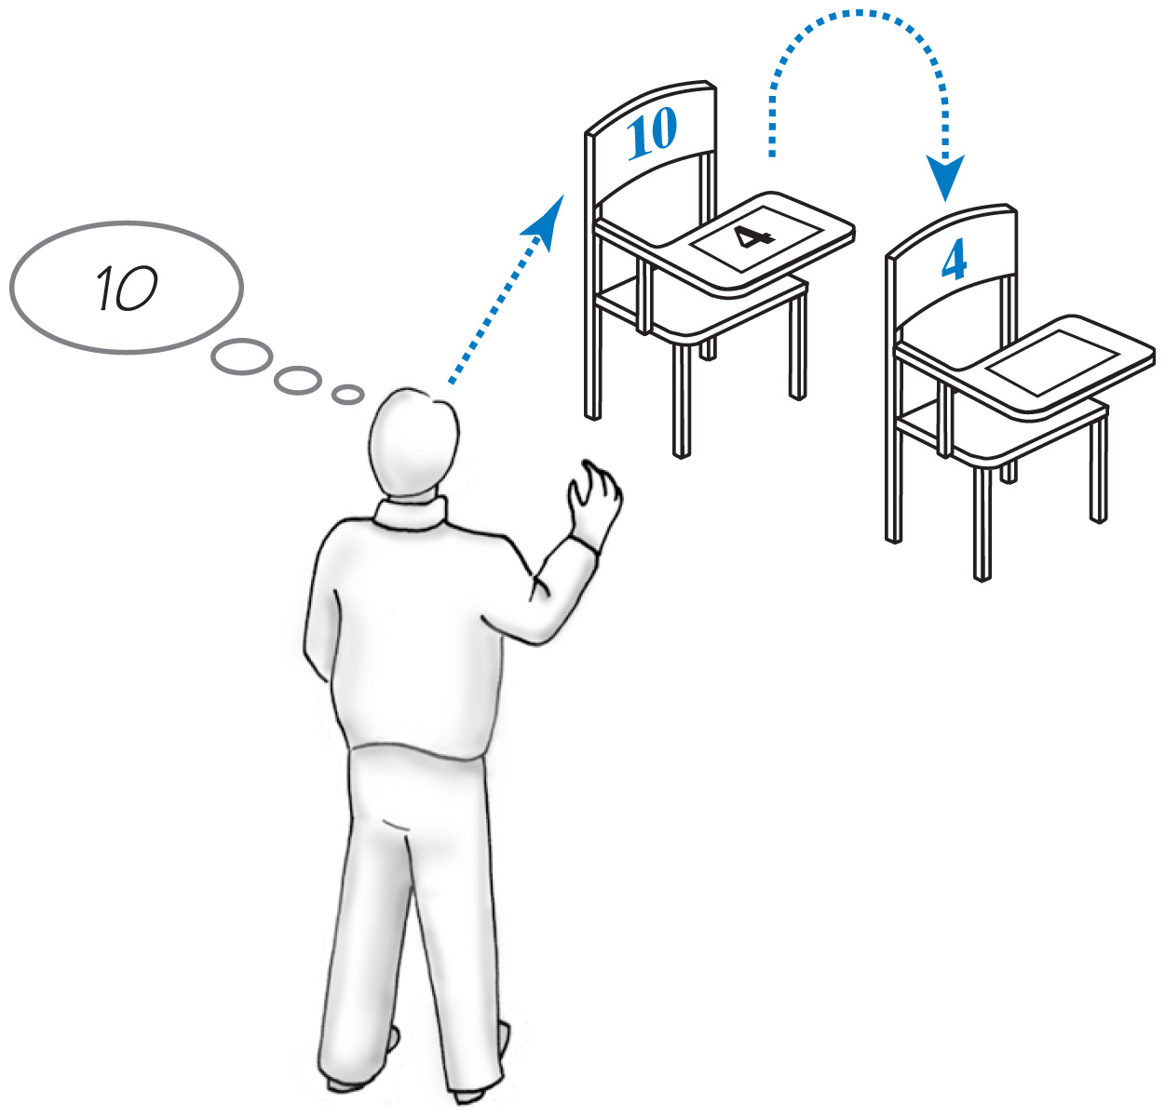
Forming a Chain by Adding to End
Fig. 6-5 Two linked desks, newest desk last.

Slide 9
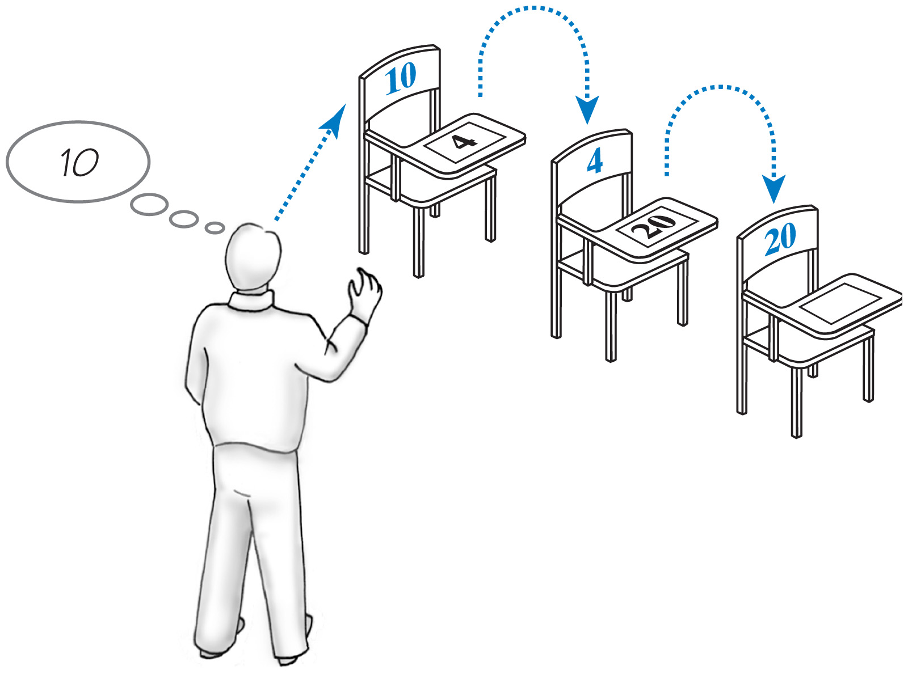
Forming a Chain by Adding to End
Fig. 6-6 Three linked desks, newest desk last.

Slide 10
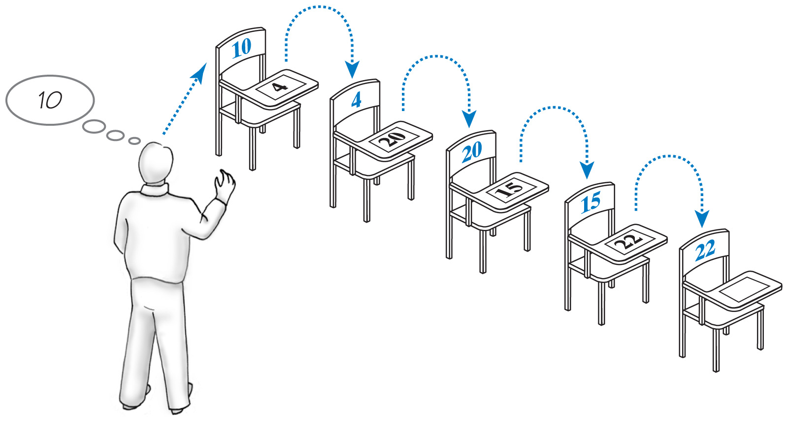
Forming a Chain by Adding to End
Fig. 6-7 Five linked desks, newest desk last.

Slide 11
Forming Chain by Adding at Various Positions
Consider the requirement to organize the chain chronologically by arrival time
New arrivals are placed somewhere in the chain, not necessarily at the end
Possibilities for placement of a new desk
Before all current desks
Between two existing desks
After all current desks

Slide 12
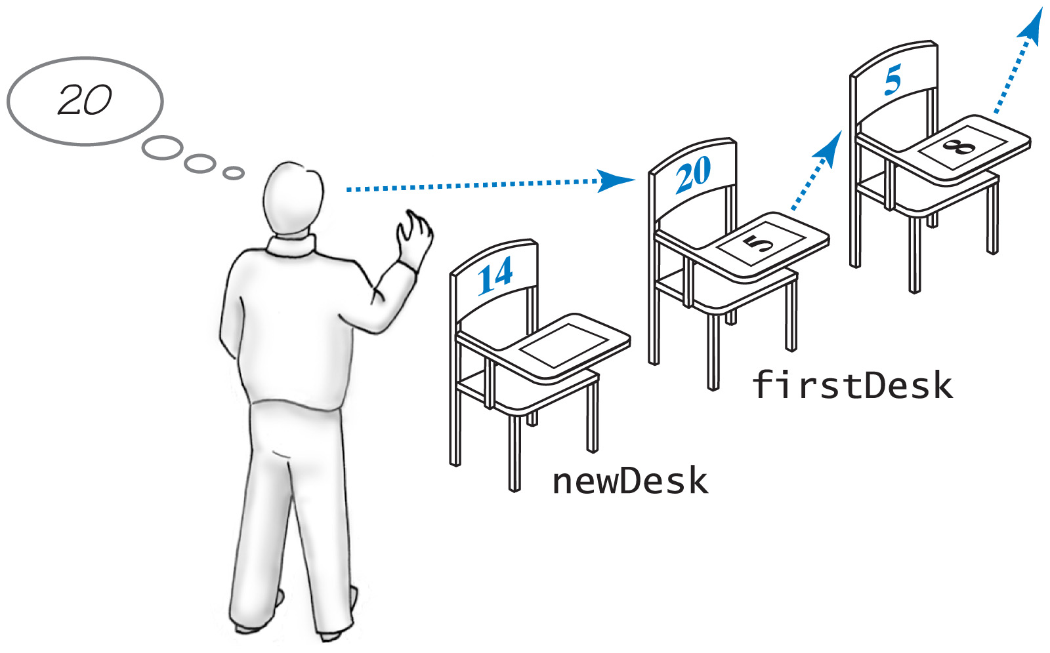
Forming Chain by Adding at Various Positions
Fig. 6-8 Chain of desks prior to adding a new desk to beginning of the chain

Slide 13
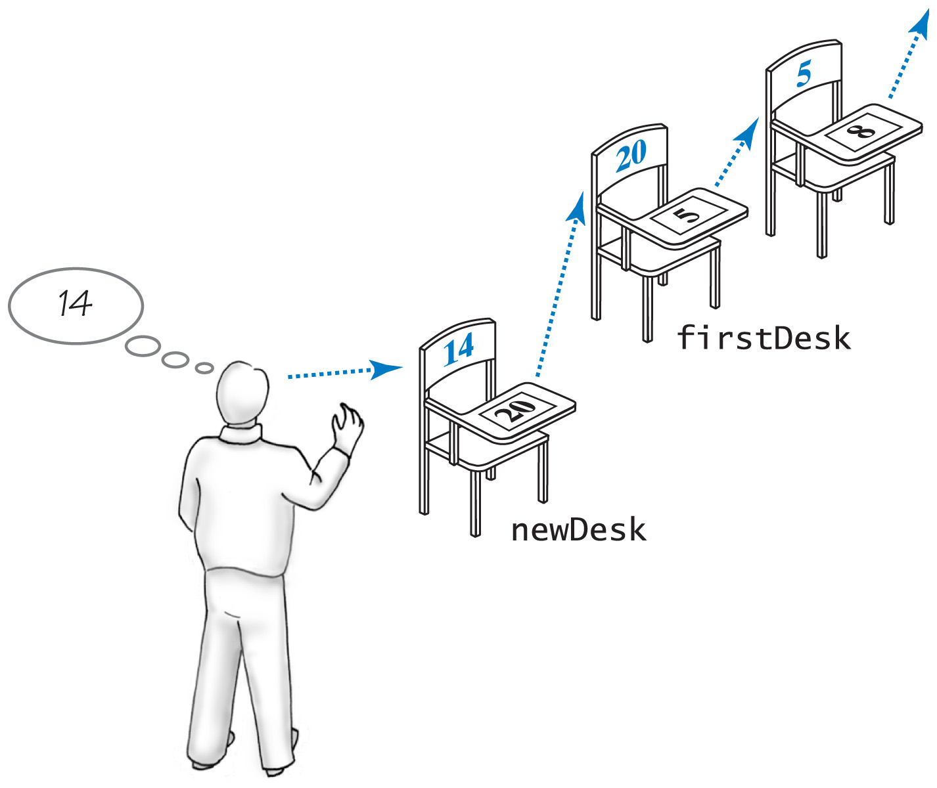
Forming Chain by Adding at Various Positions
Fig. 6-9 Addition of a new desk to beginning of a chain of desks

Slide 14
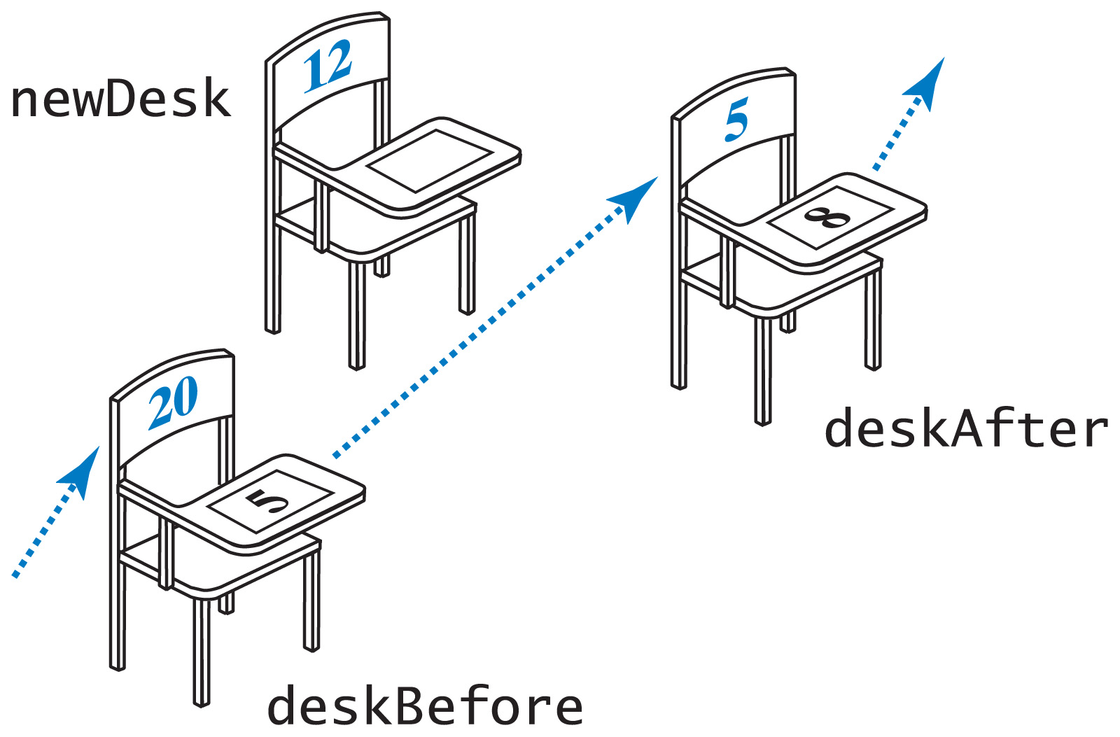
Forming Chain by Adding at Various Positions
Fig. 6-10 Two consecutive desks within a chain prior to adding new desk between

Slide 15
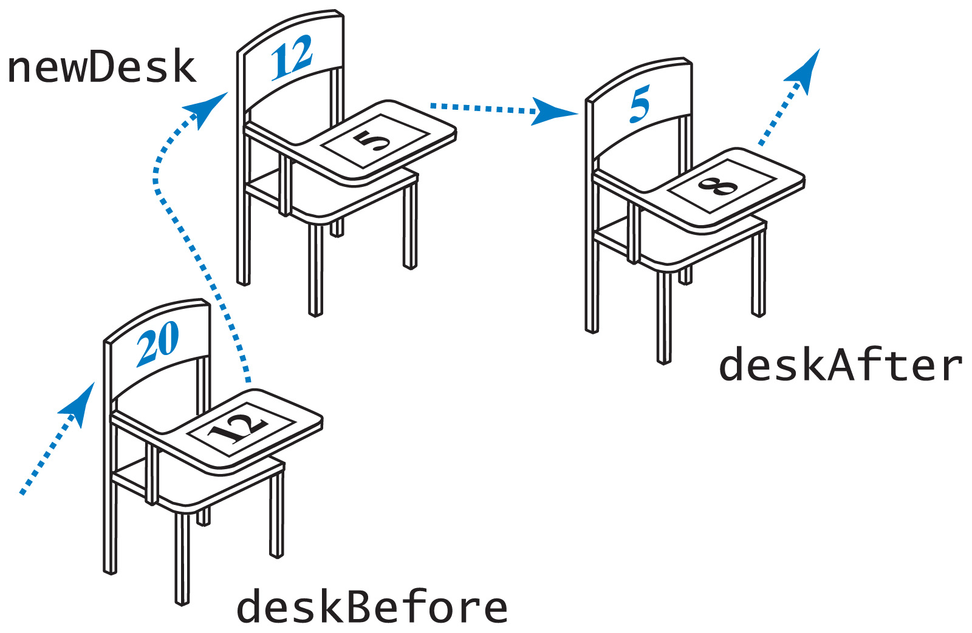
Forming Chain by Adding at Various Positions
Fig. 6-11 Addition of a new desk between two other desks.

Slide 16
The Class Node
Nodes are objects that are linked together to form a data structure
We will use nodes with two data fields
A reference to an entry in the list
A reference to another node
View class definition of Node

Slide 17
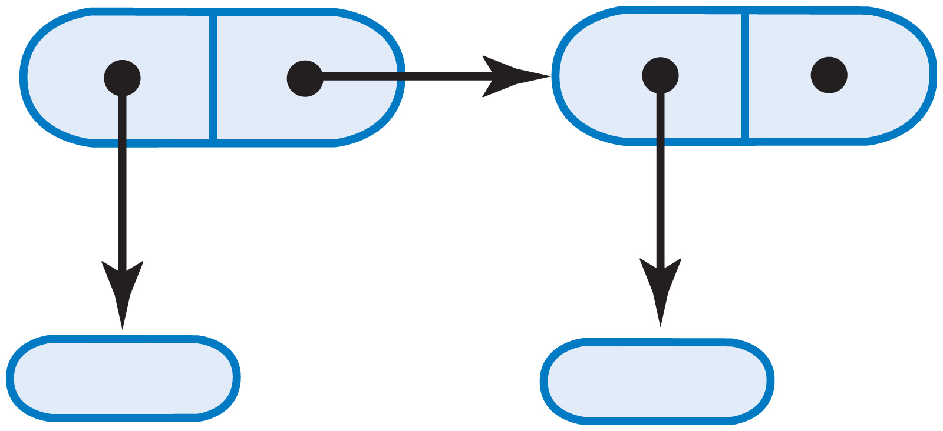
The Class Node
Fig. 6-12 Two linked nodes that each reference object data

Slide 18
A Linked Implementation of the ADT List
Use a chain of nodes
Remember the address of the first node in the chain
Record a reference to the first node
The “head reference”

Slide 19
Choosing a Core Group of Methods
Must be able to create the collection
Need method add()
Desire to see objects that have been added to the list
Need method display()
Constructor also necessary

Slide 20
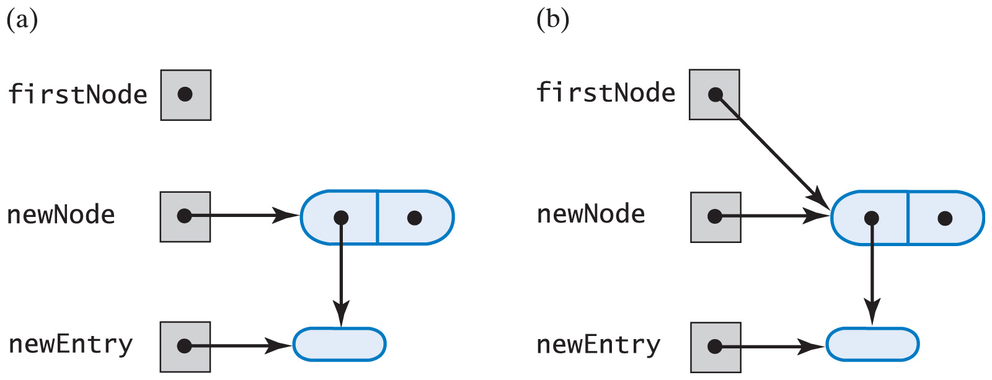
Adding to the End of the List
Fig. 6-13 (a) An empty list and a new node; (b) after adding a new node to a list that was empty

Slide 21
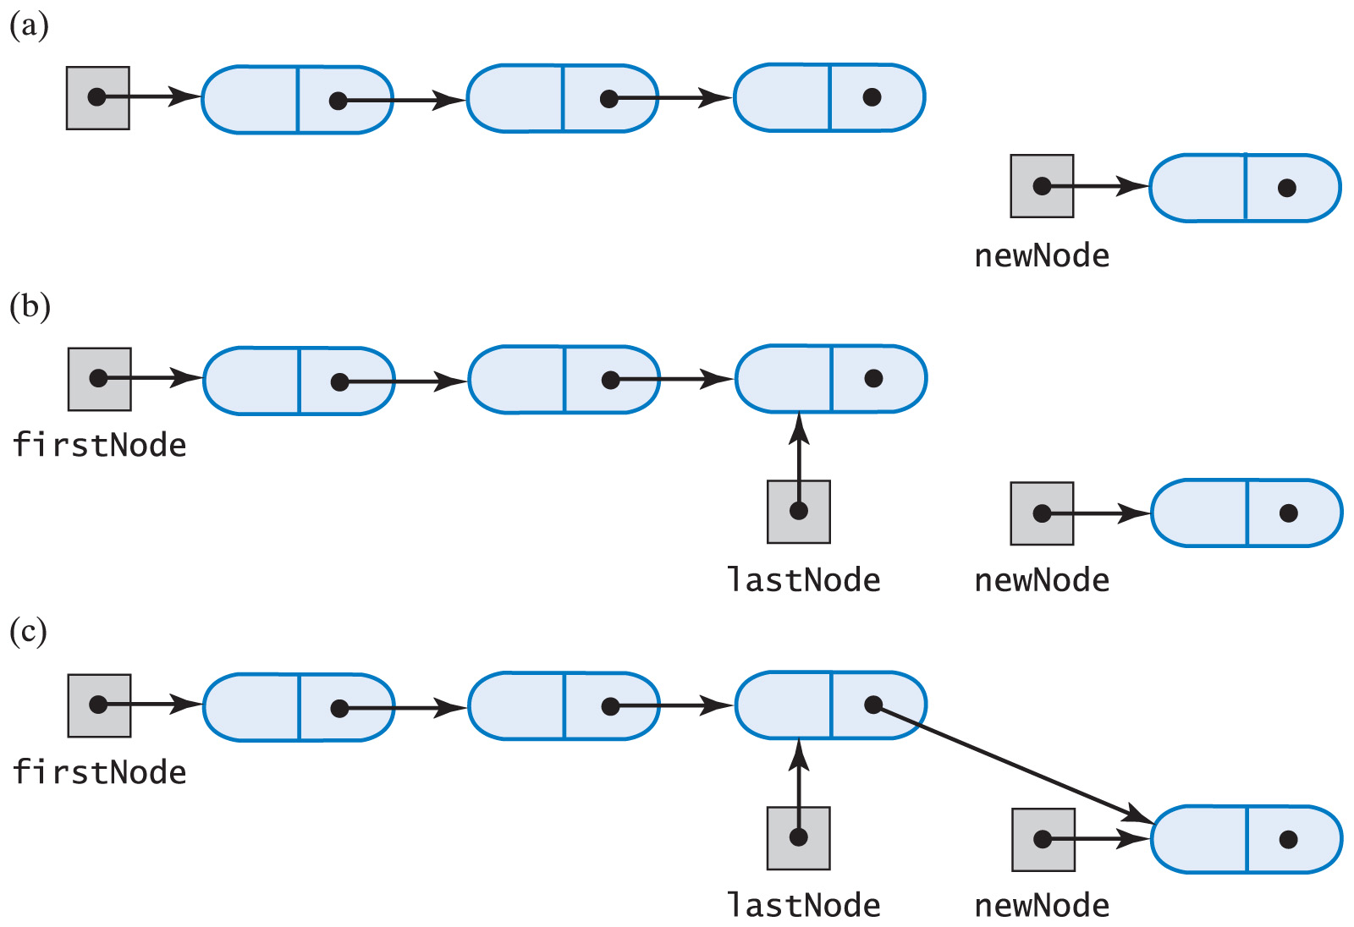
Adding to the End of the List
Fig. 6-14 A chain of nodes (a) just prior to adding a node at the end; (b) just after adding a node at the end.

Slide 22
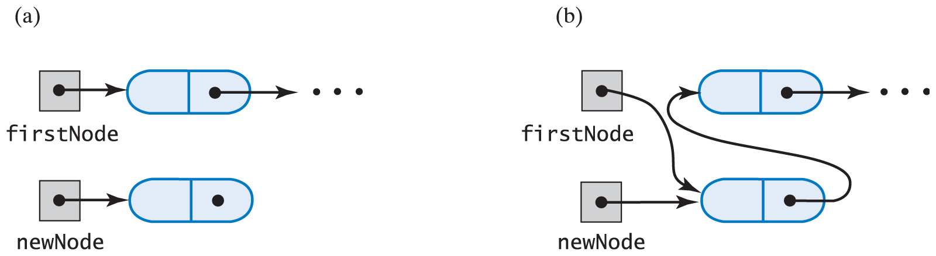
Adding at Beginning of the List
Fig. 6-15 A chain of nodes (a) prior to adding a node at the beginning; (b) after adding a node at the beginning.

Slide 23
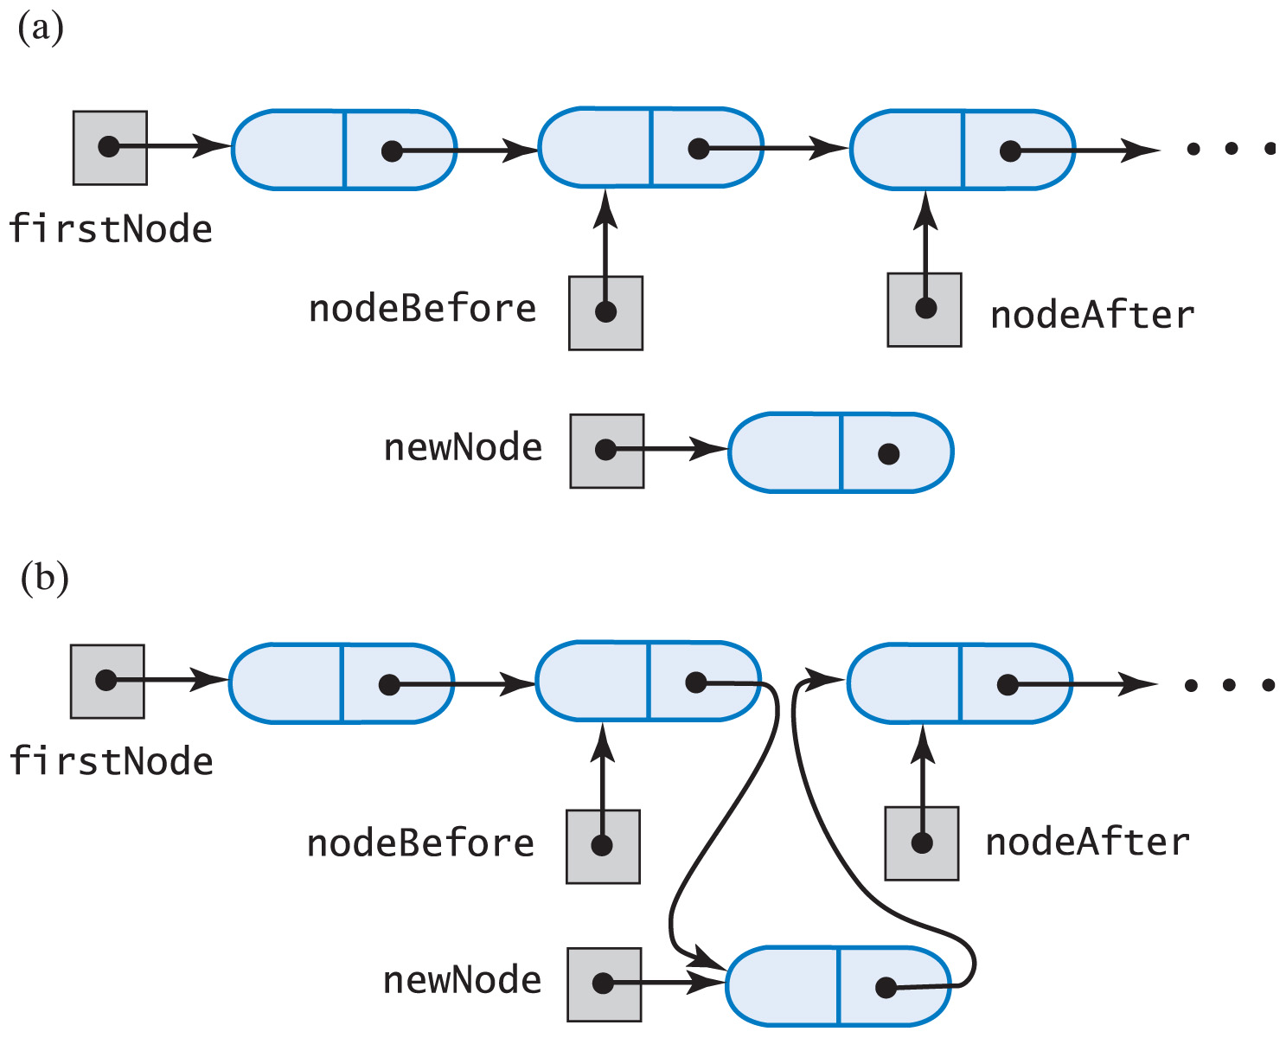
Adding at a Given Position Within the List
Fig. 6-16 A chain of nodes (a) prior to adding node between adjacent nodes; (b) after adding node between adjacent nodes

Slide 24
Other Core Methods Implemented
Method display()
Sends output to System.out
Private method getNodeAt()

